Slide 1
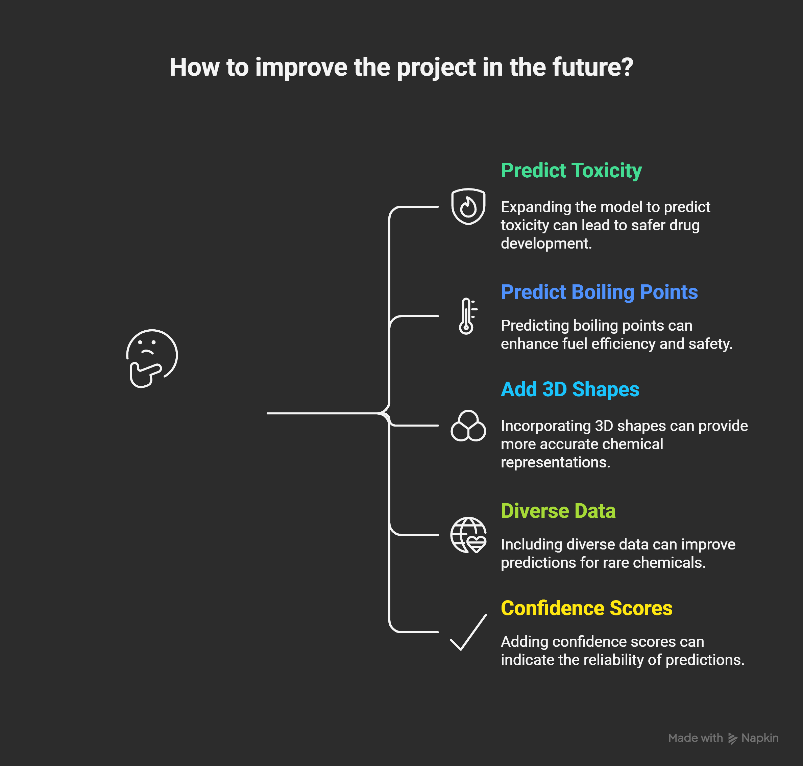
Lipophilicity prediction ⚗️ using ML🖥️🧪

Slide 2
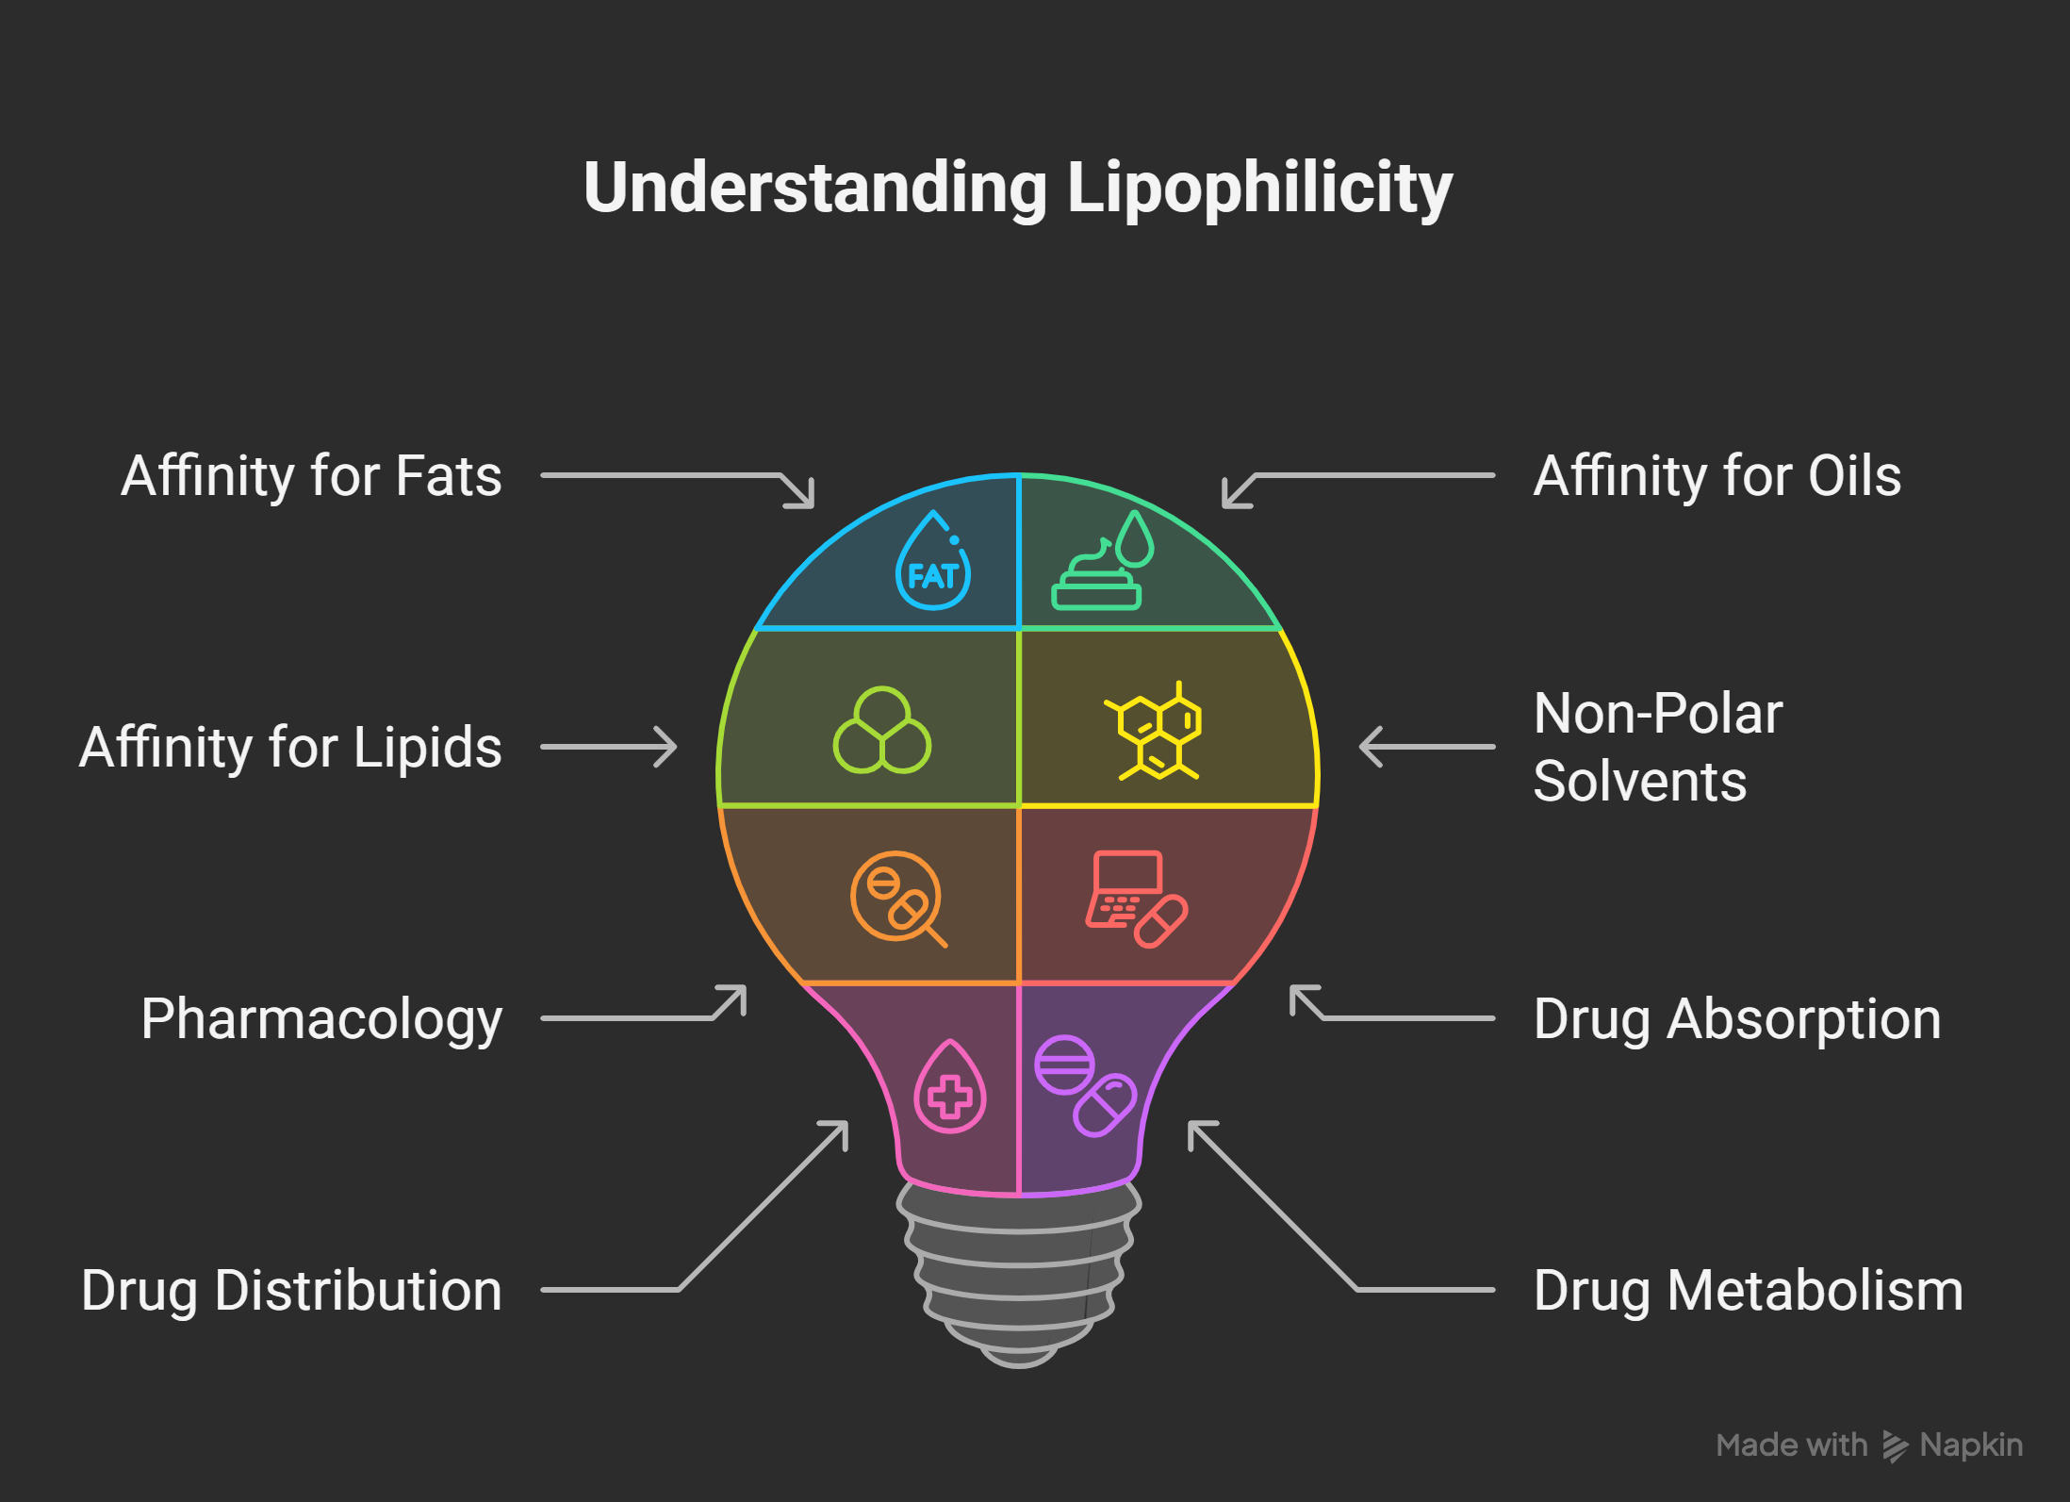

Slide 3
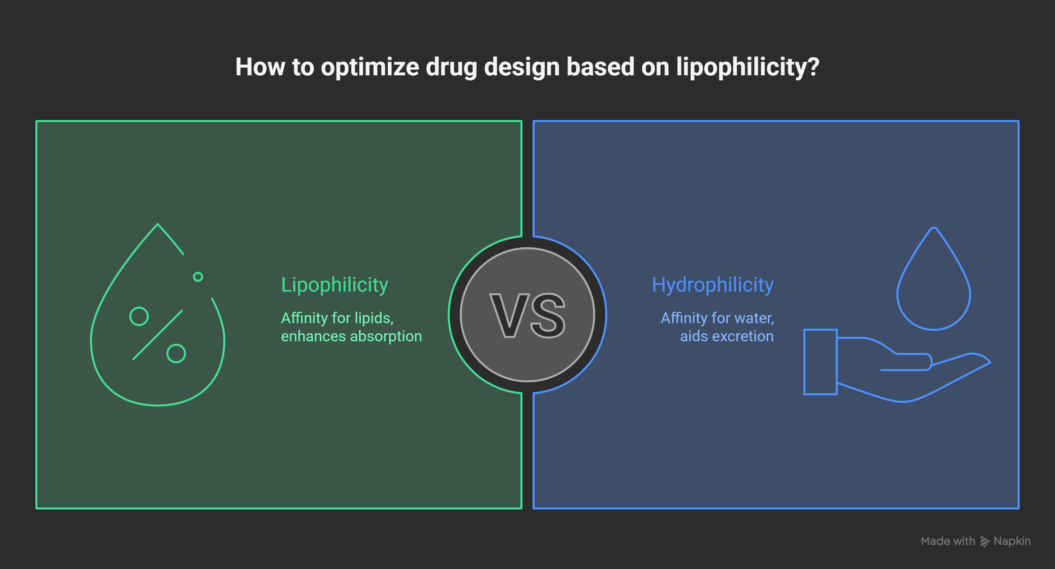

Slide 4
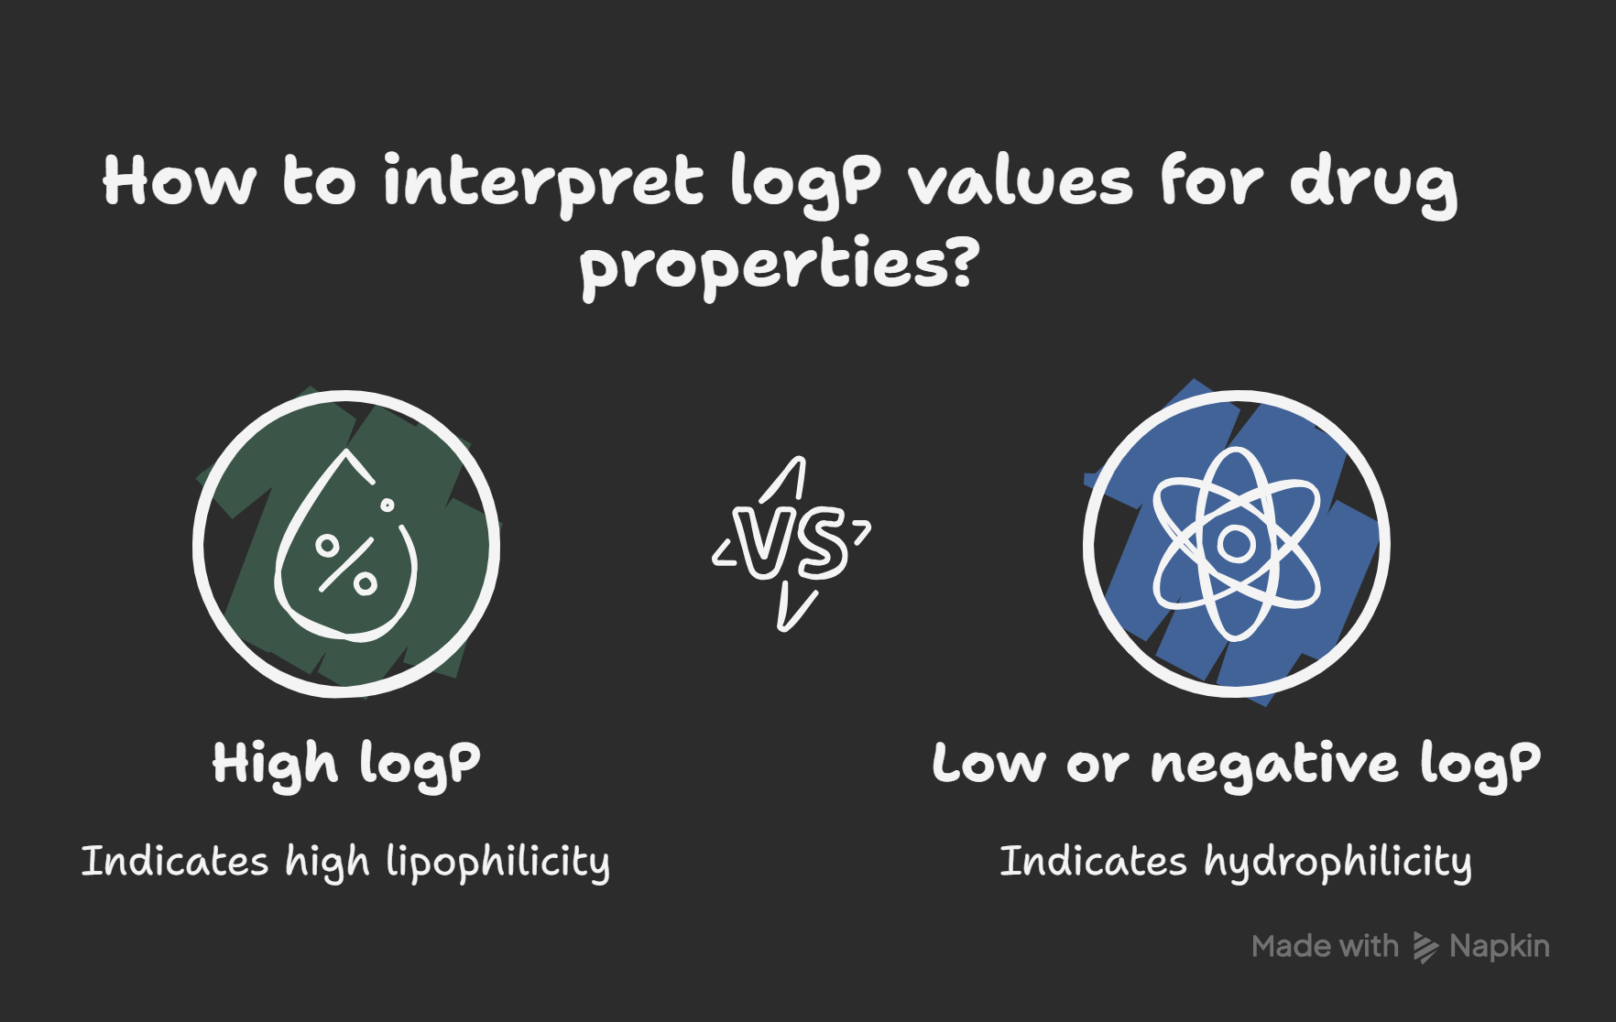

Slide 5
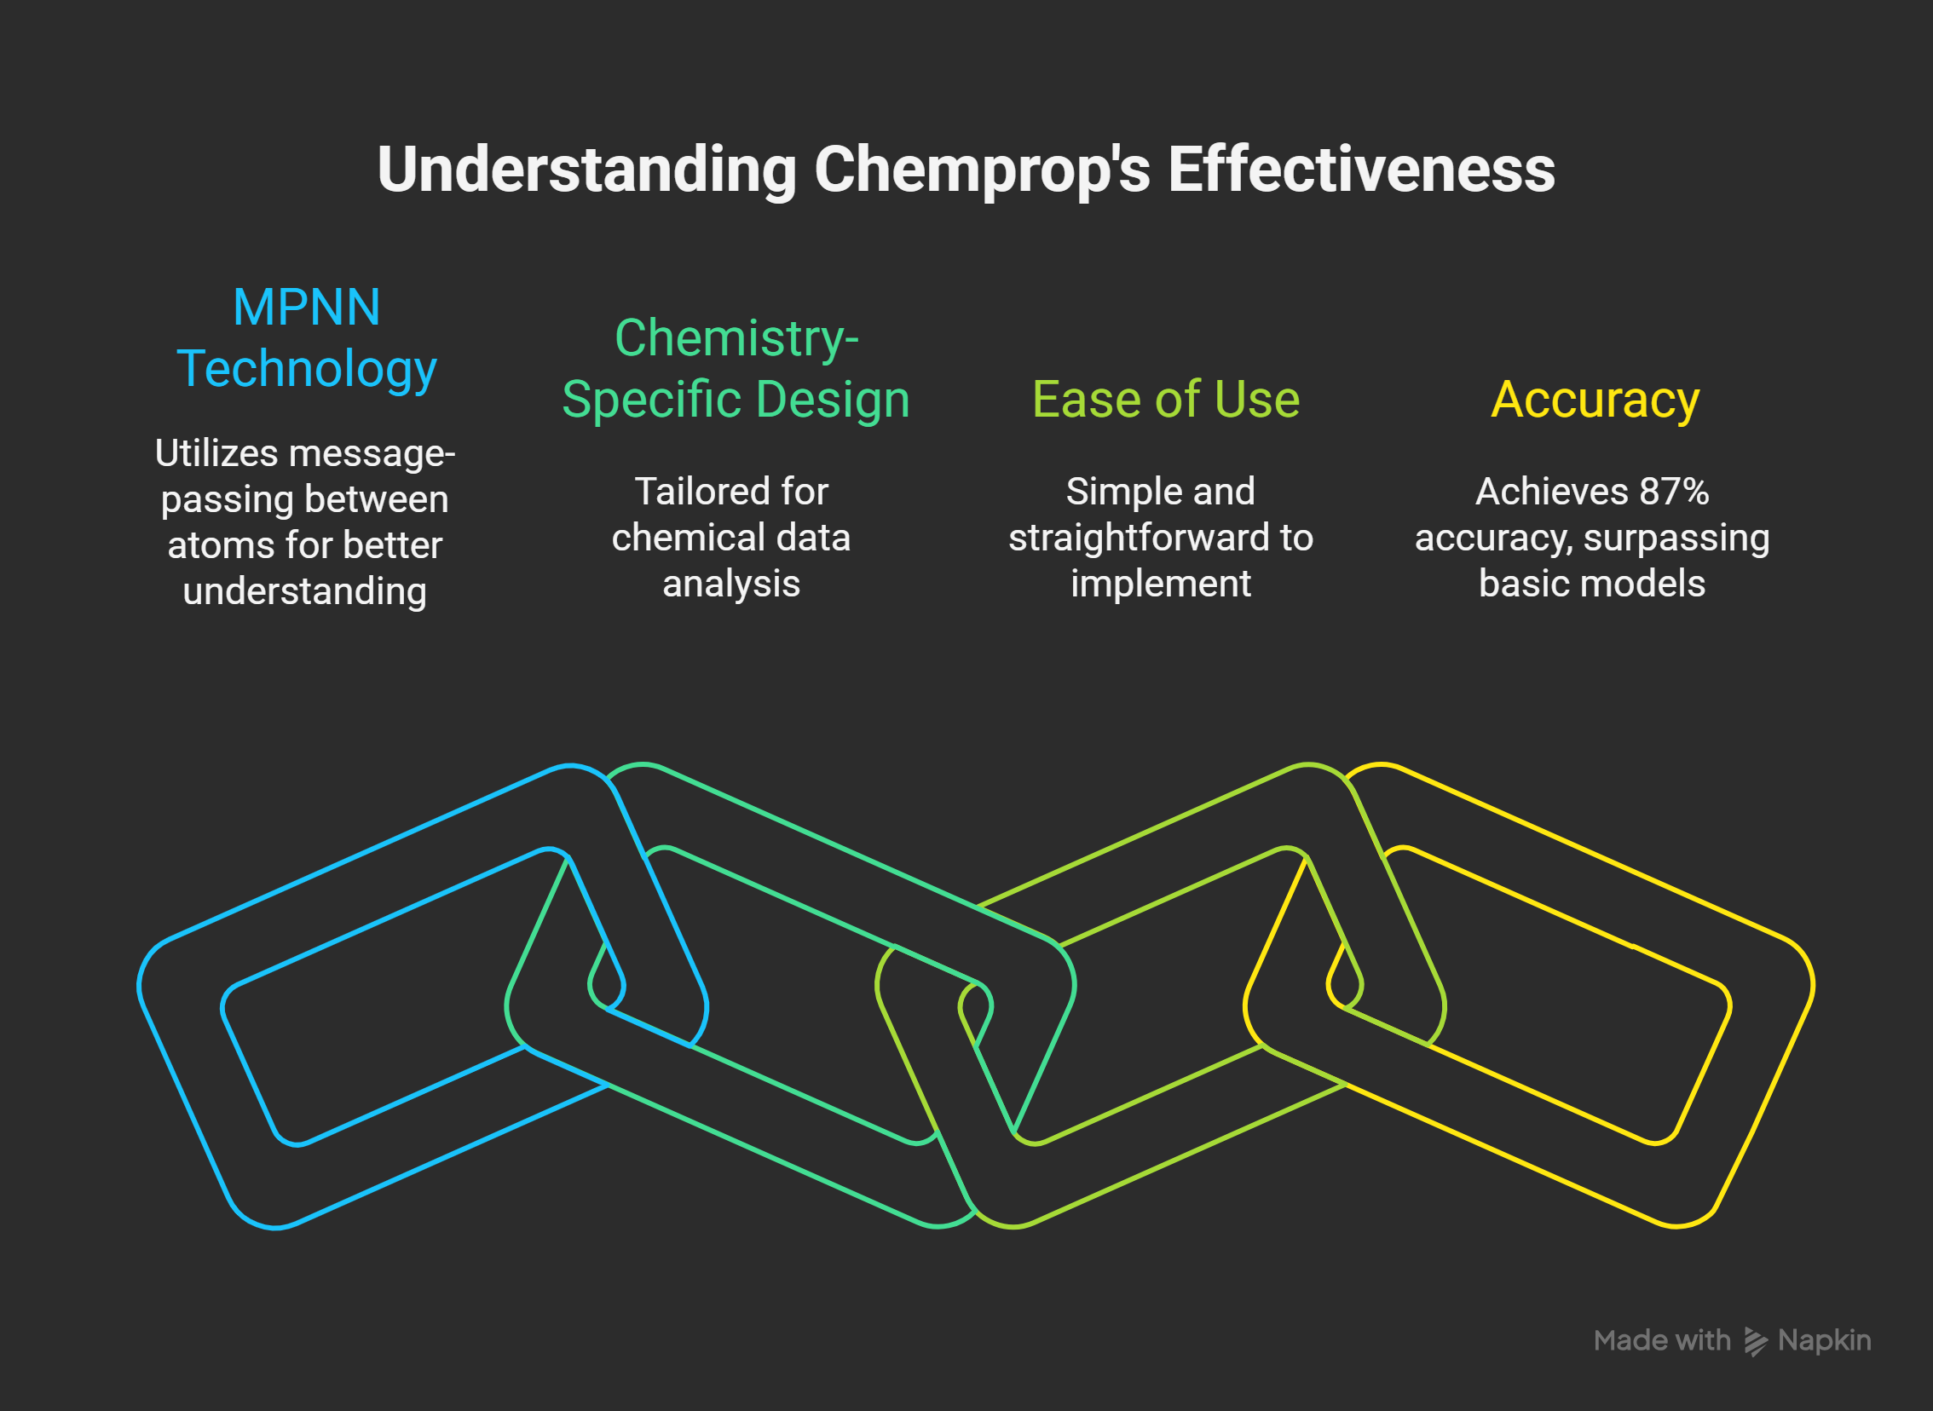

Slide 6
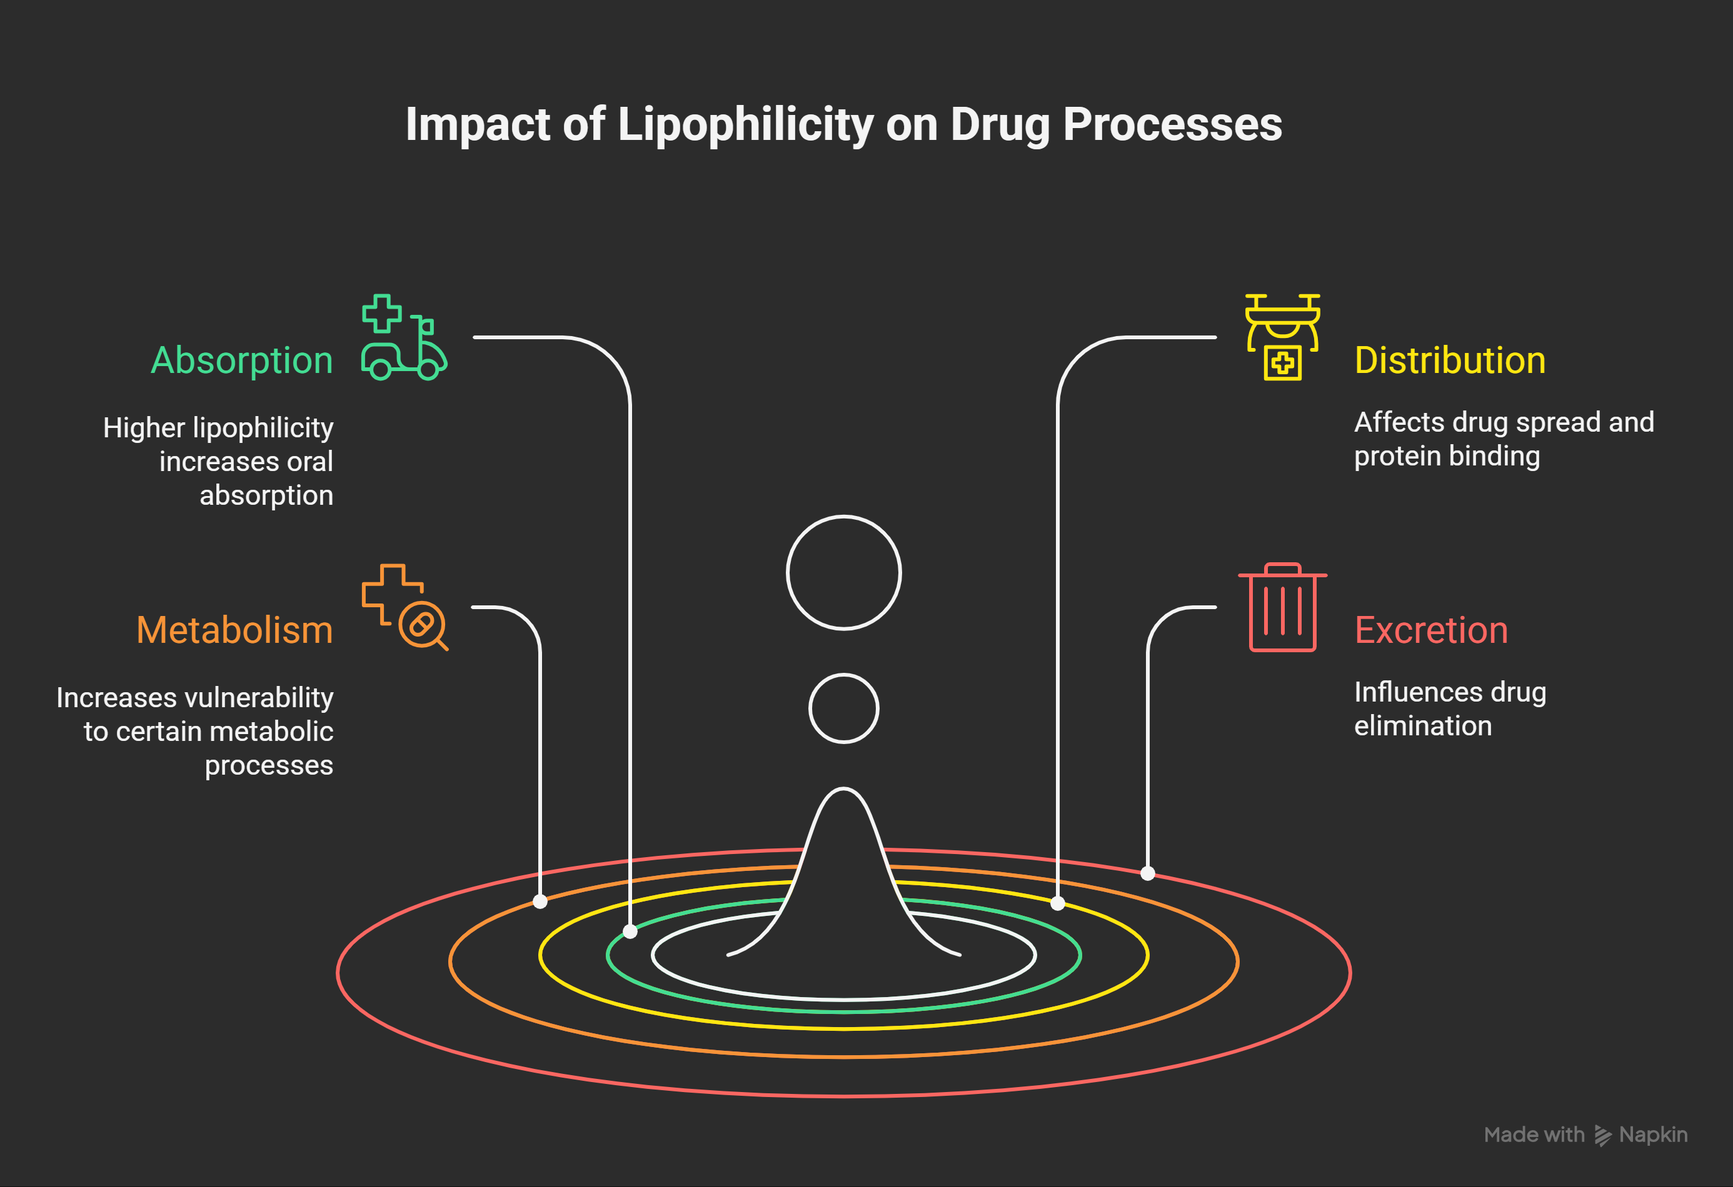

Slide 7
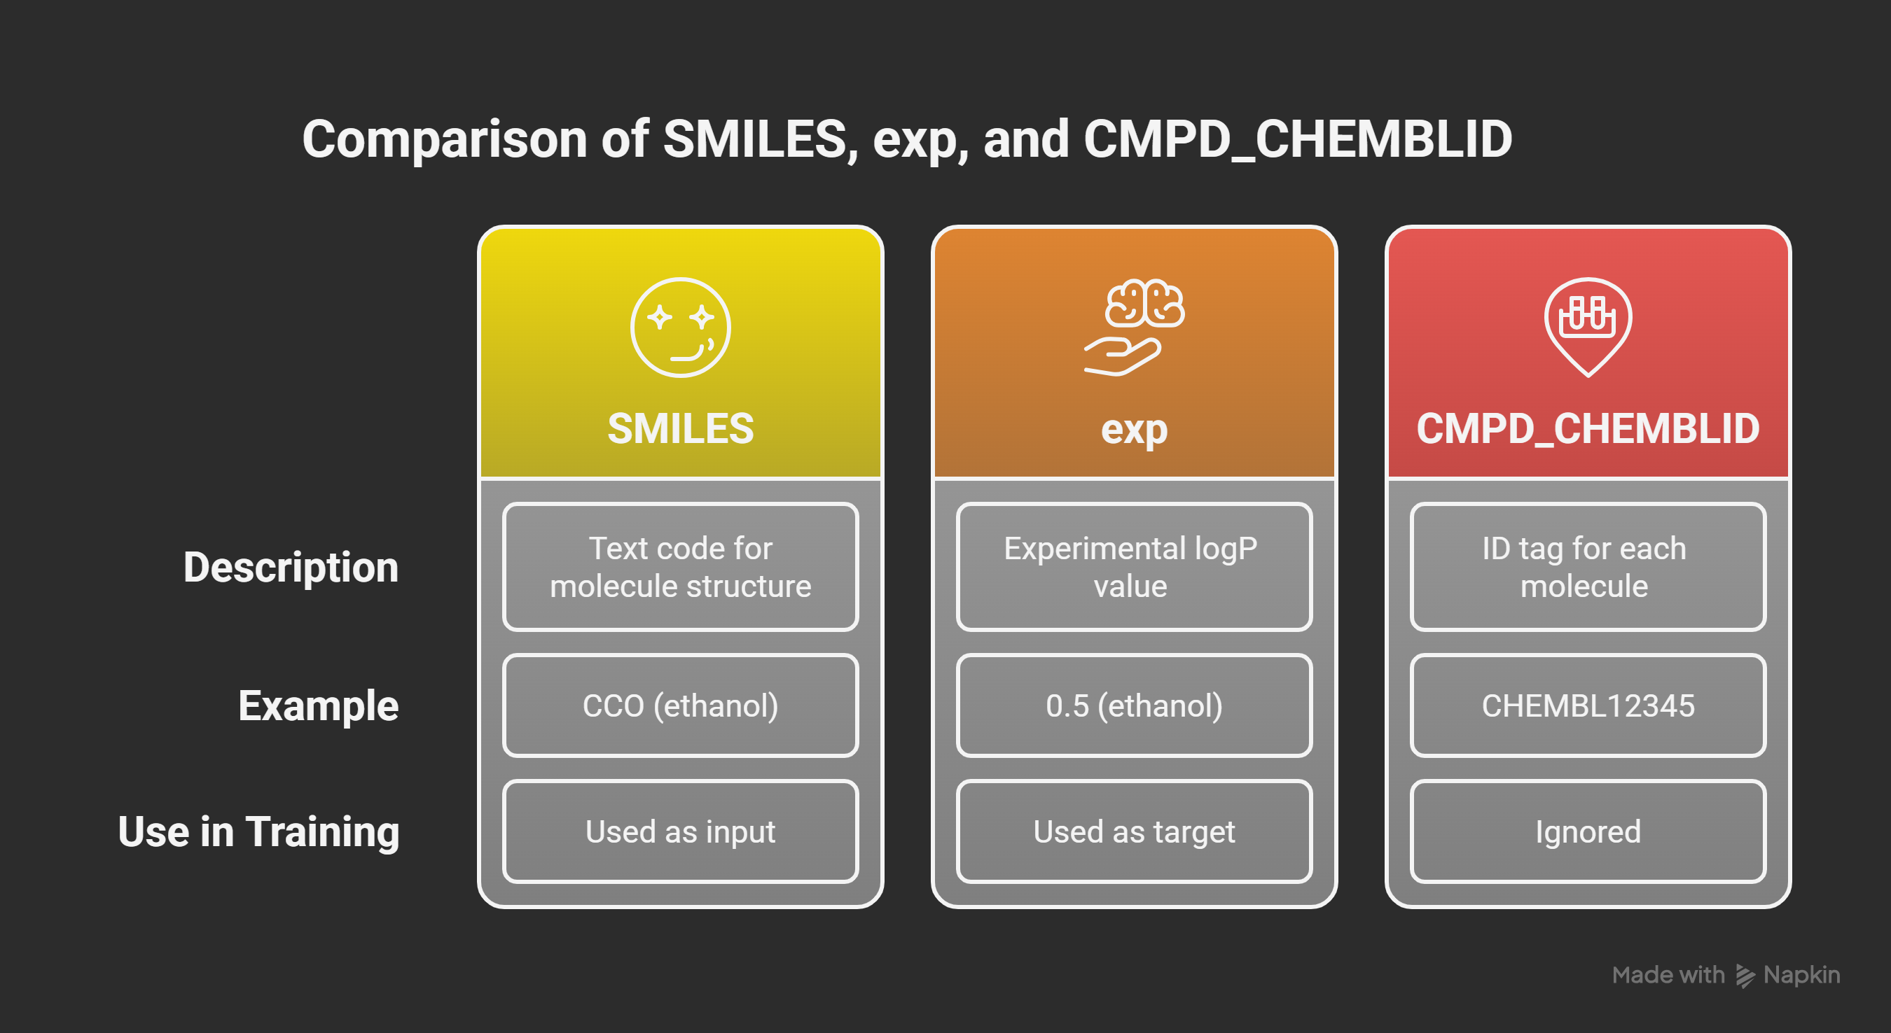

Slide 8
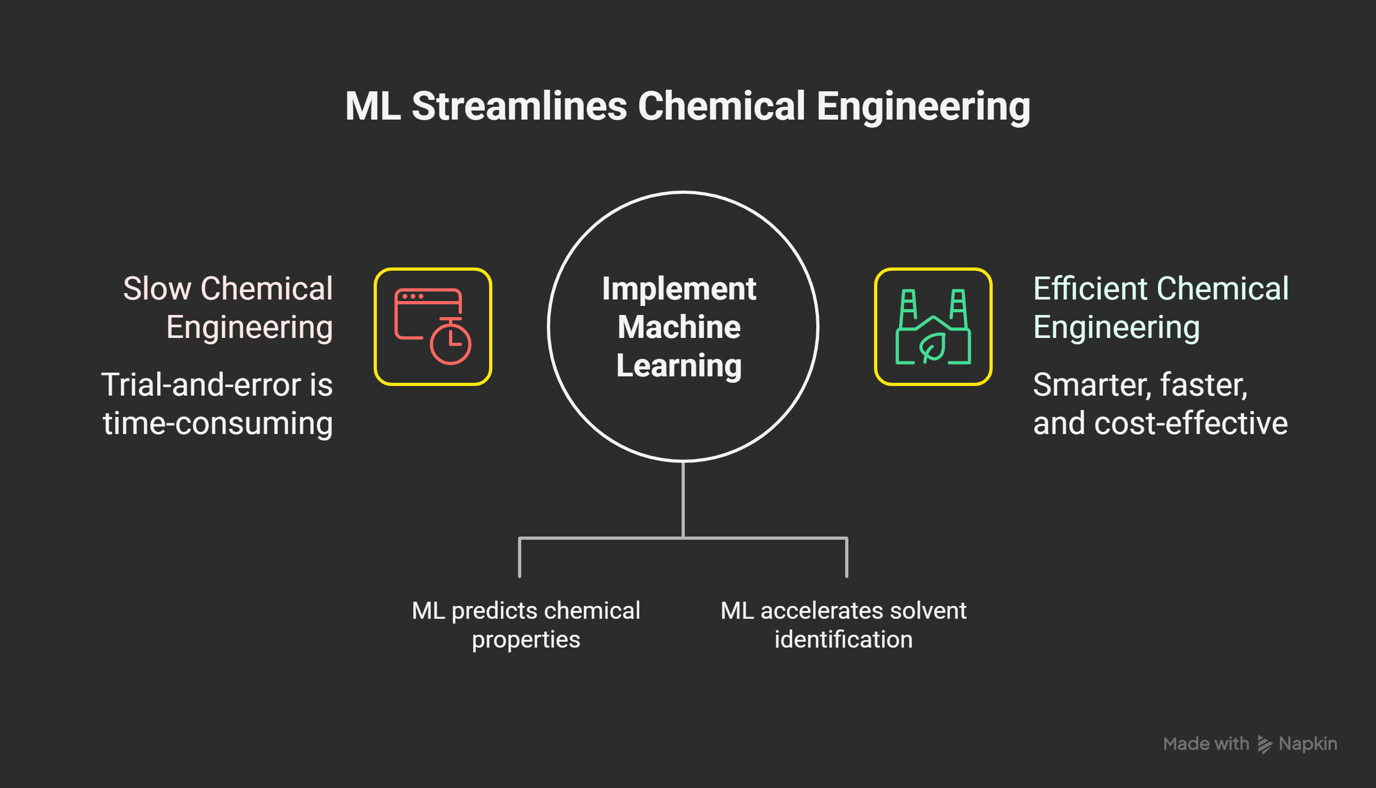


Slide 9
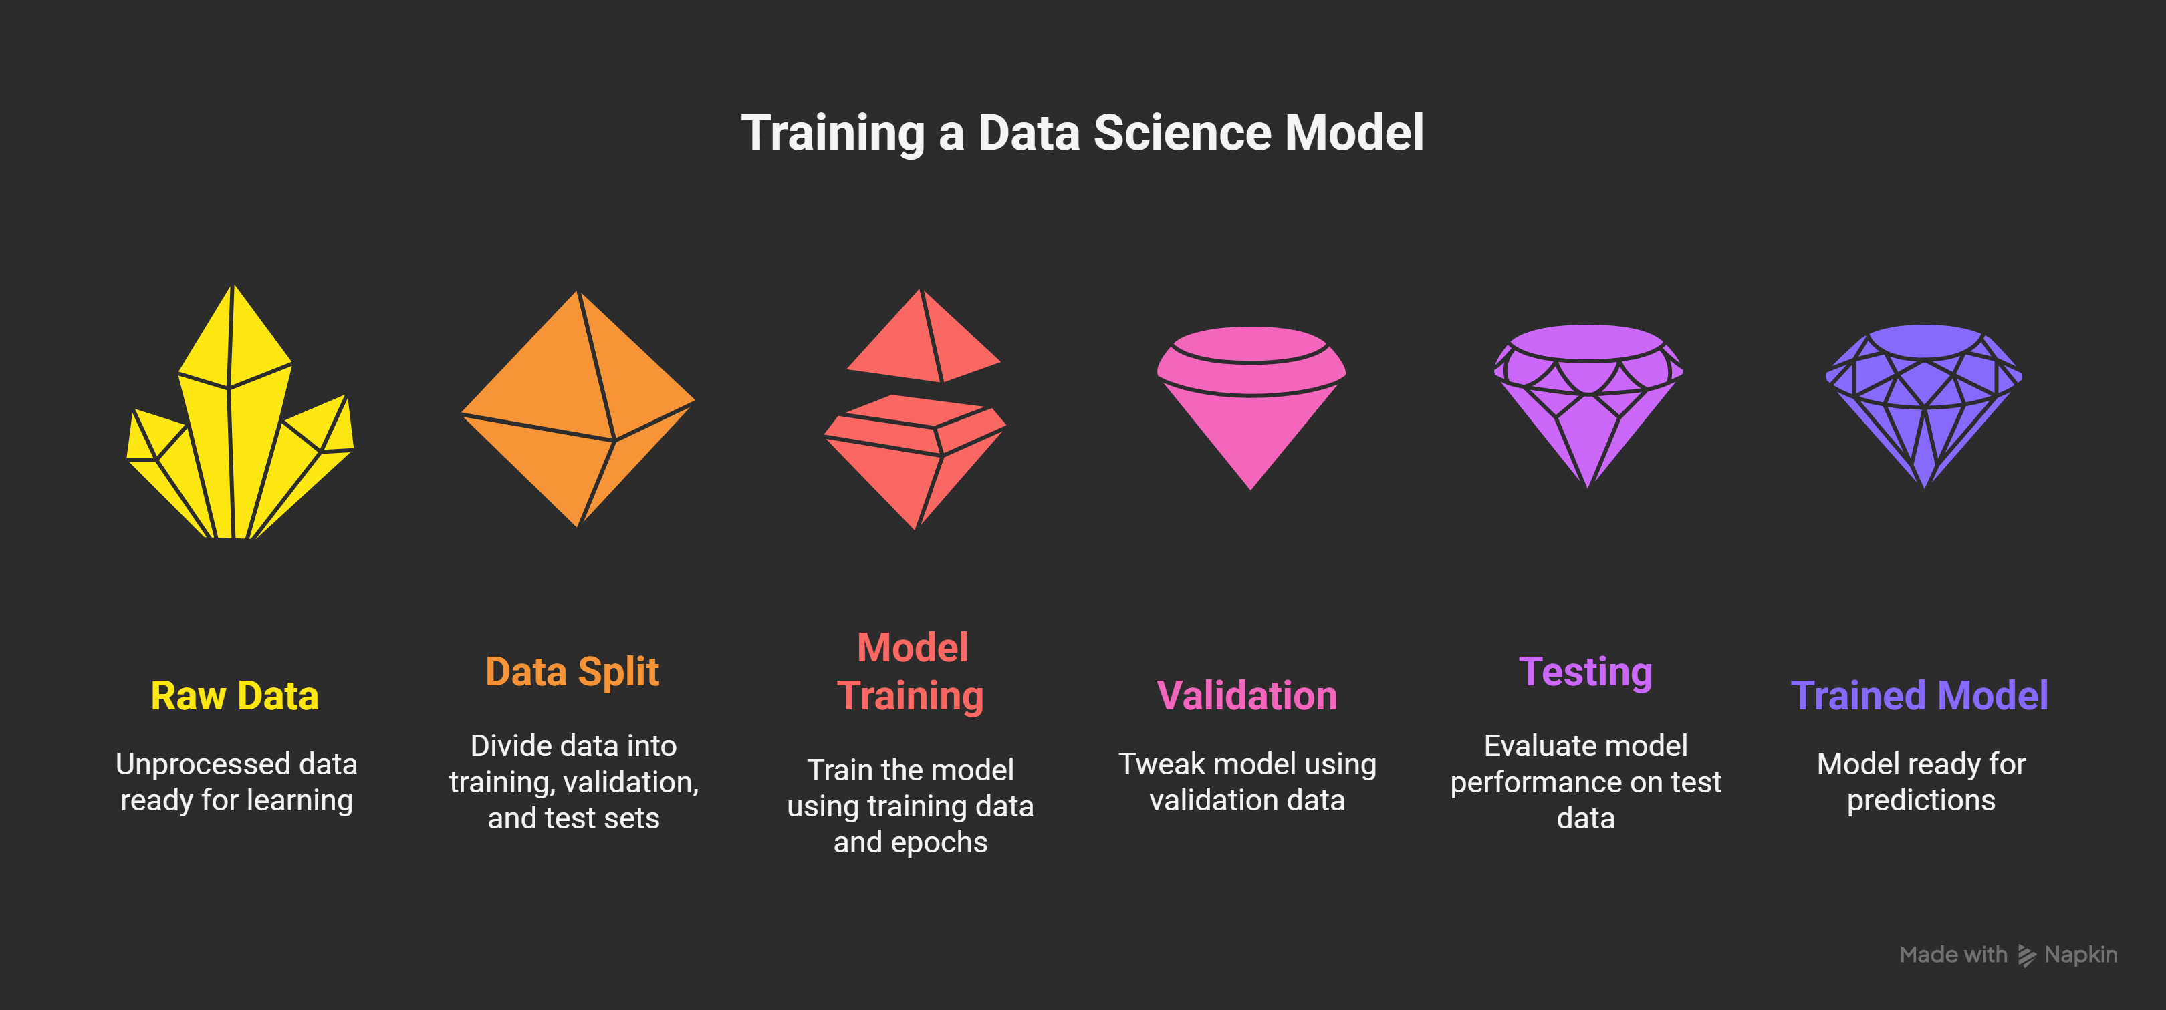

Slide 10
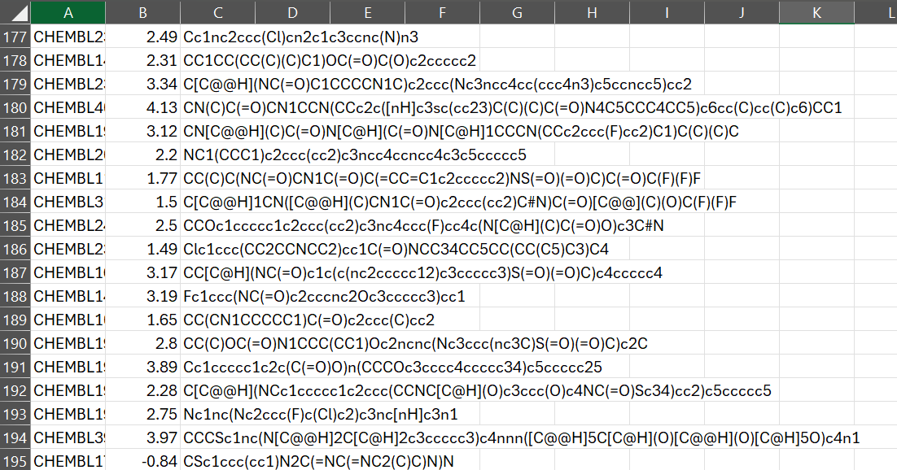


Slide 11
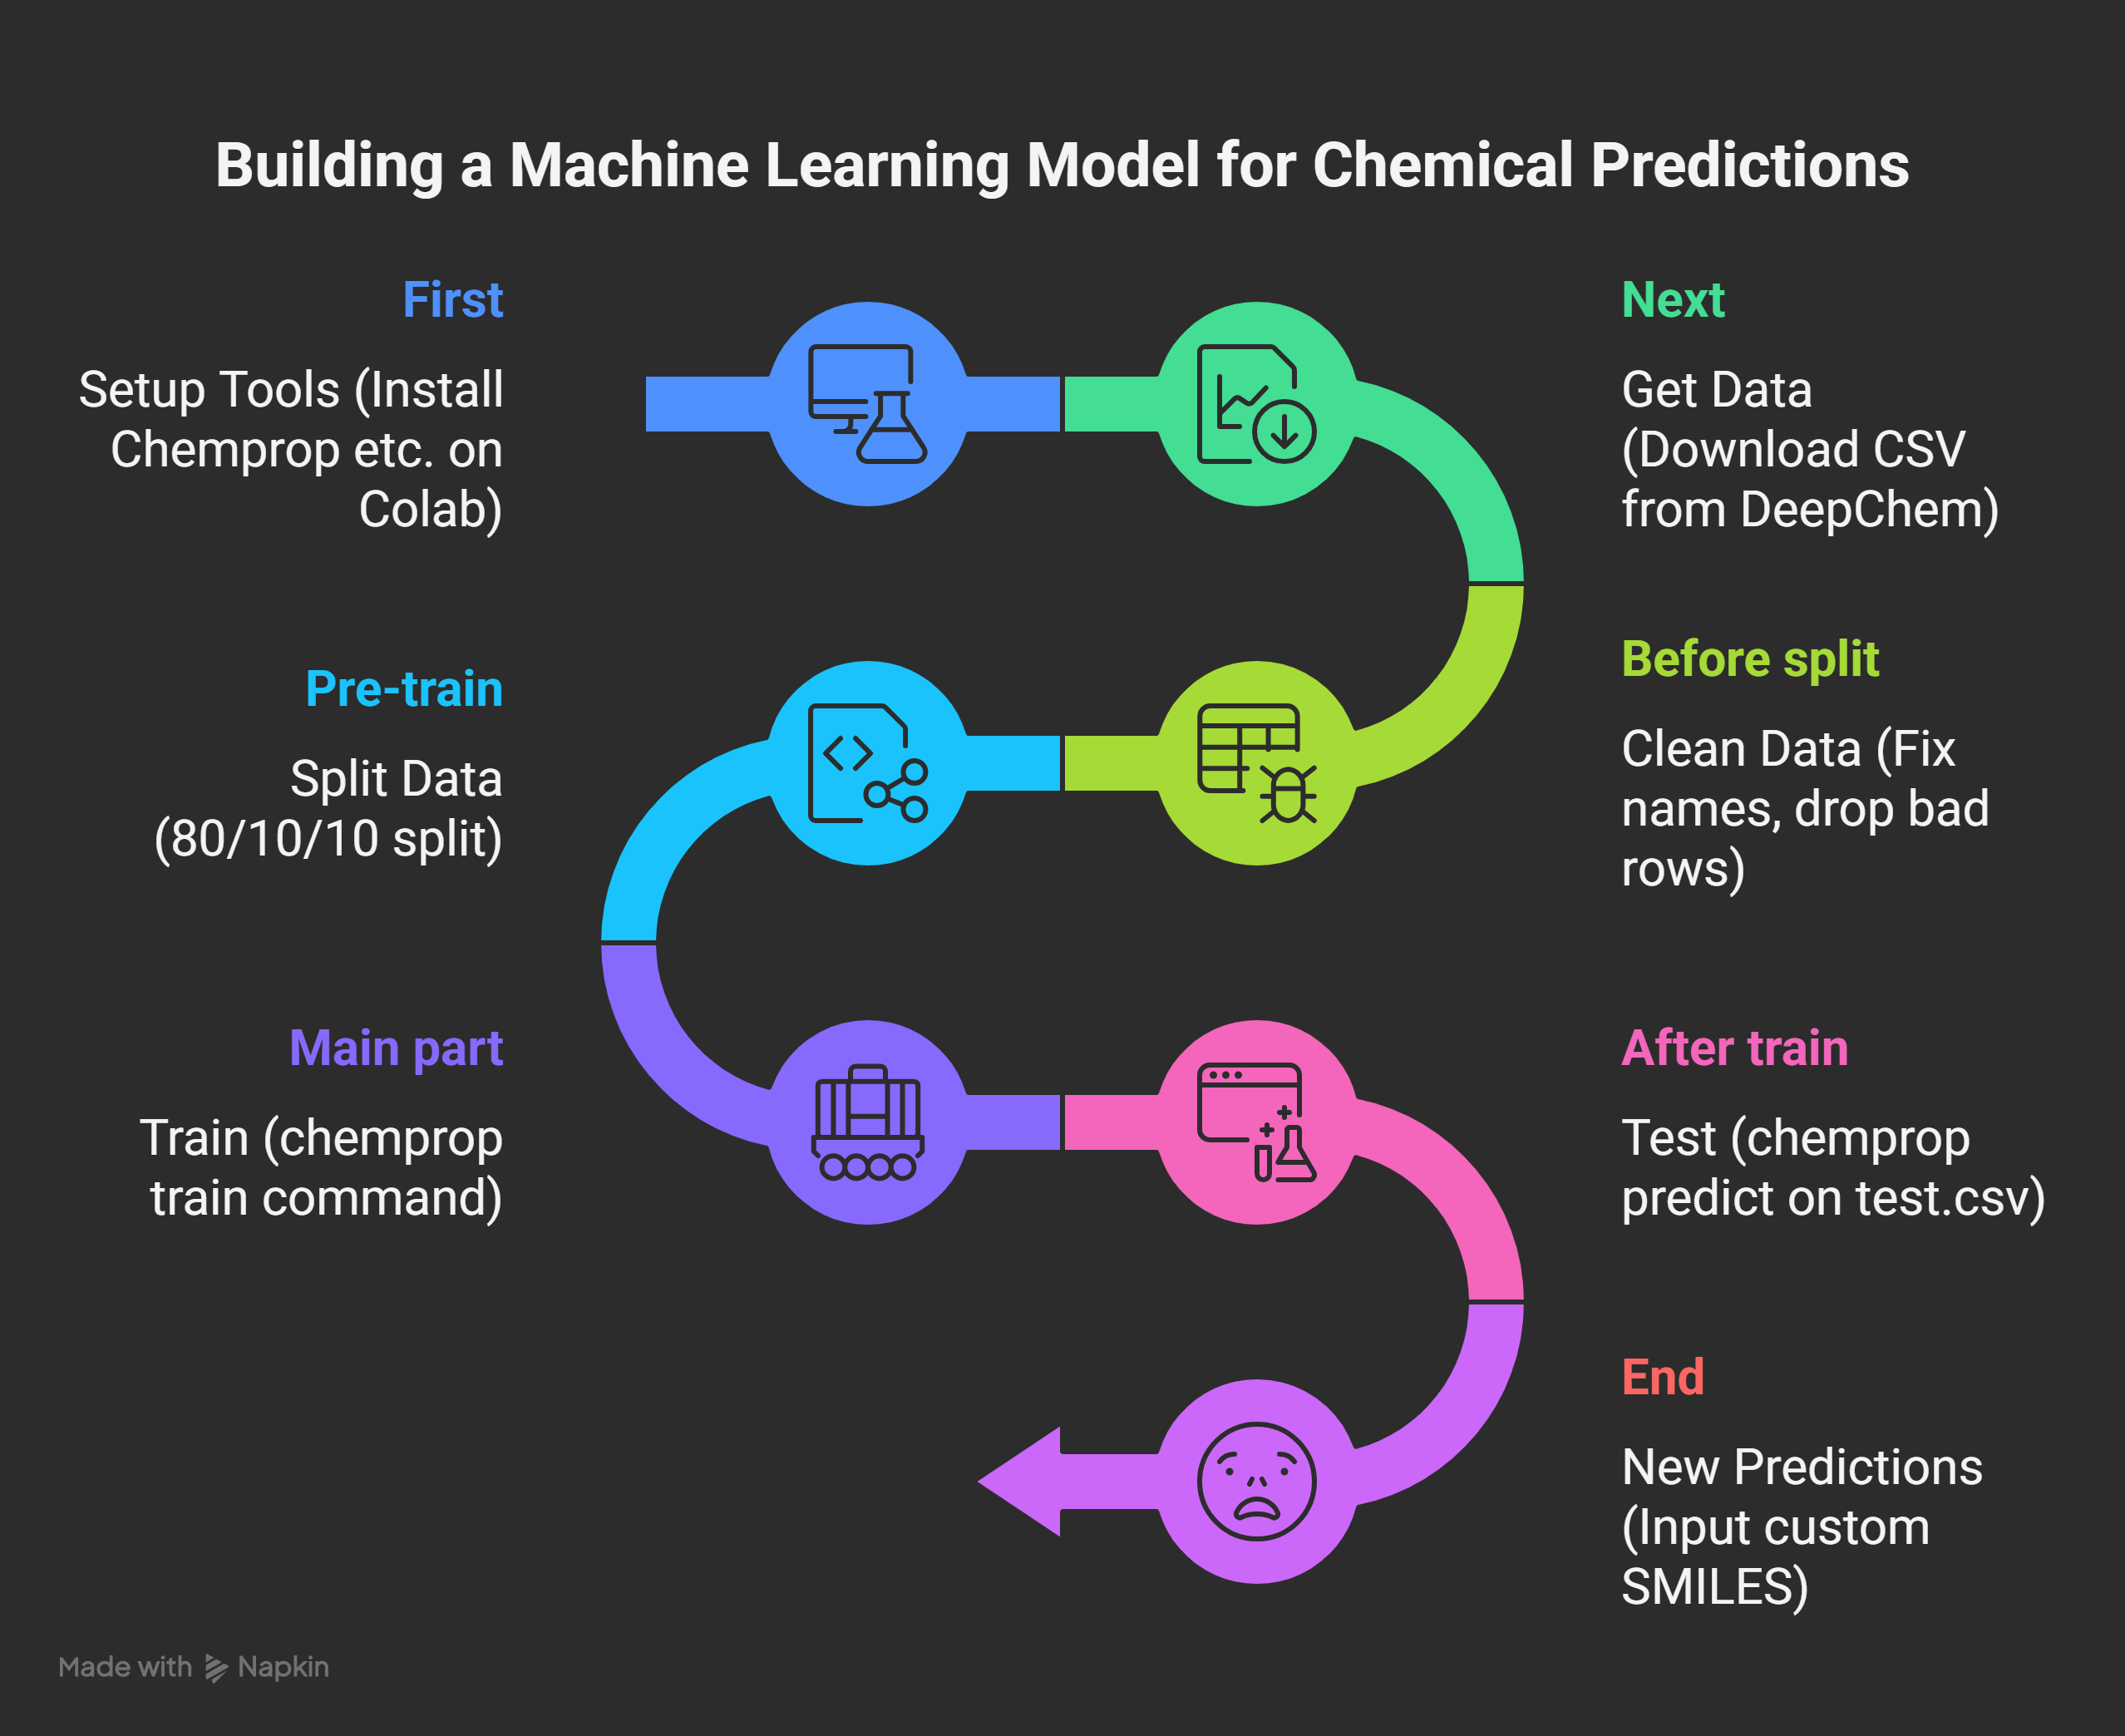

Slide 12
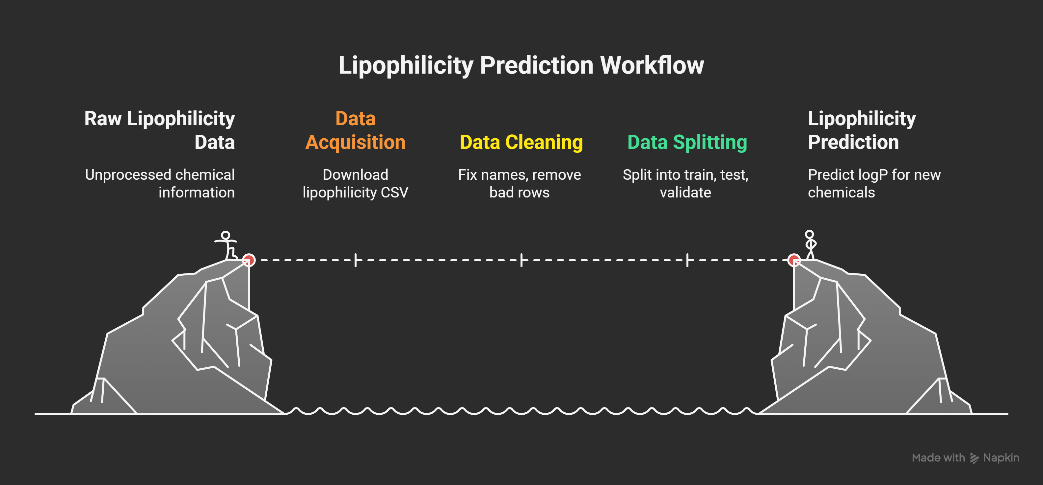

Slide 13
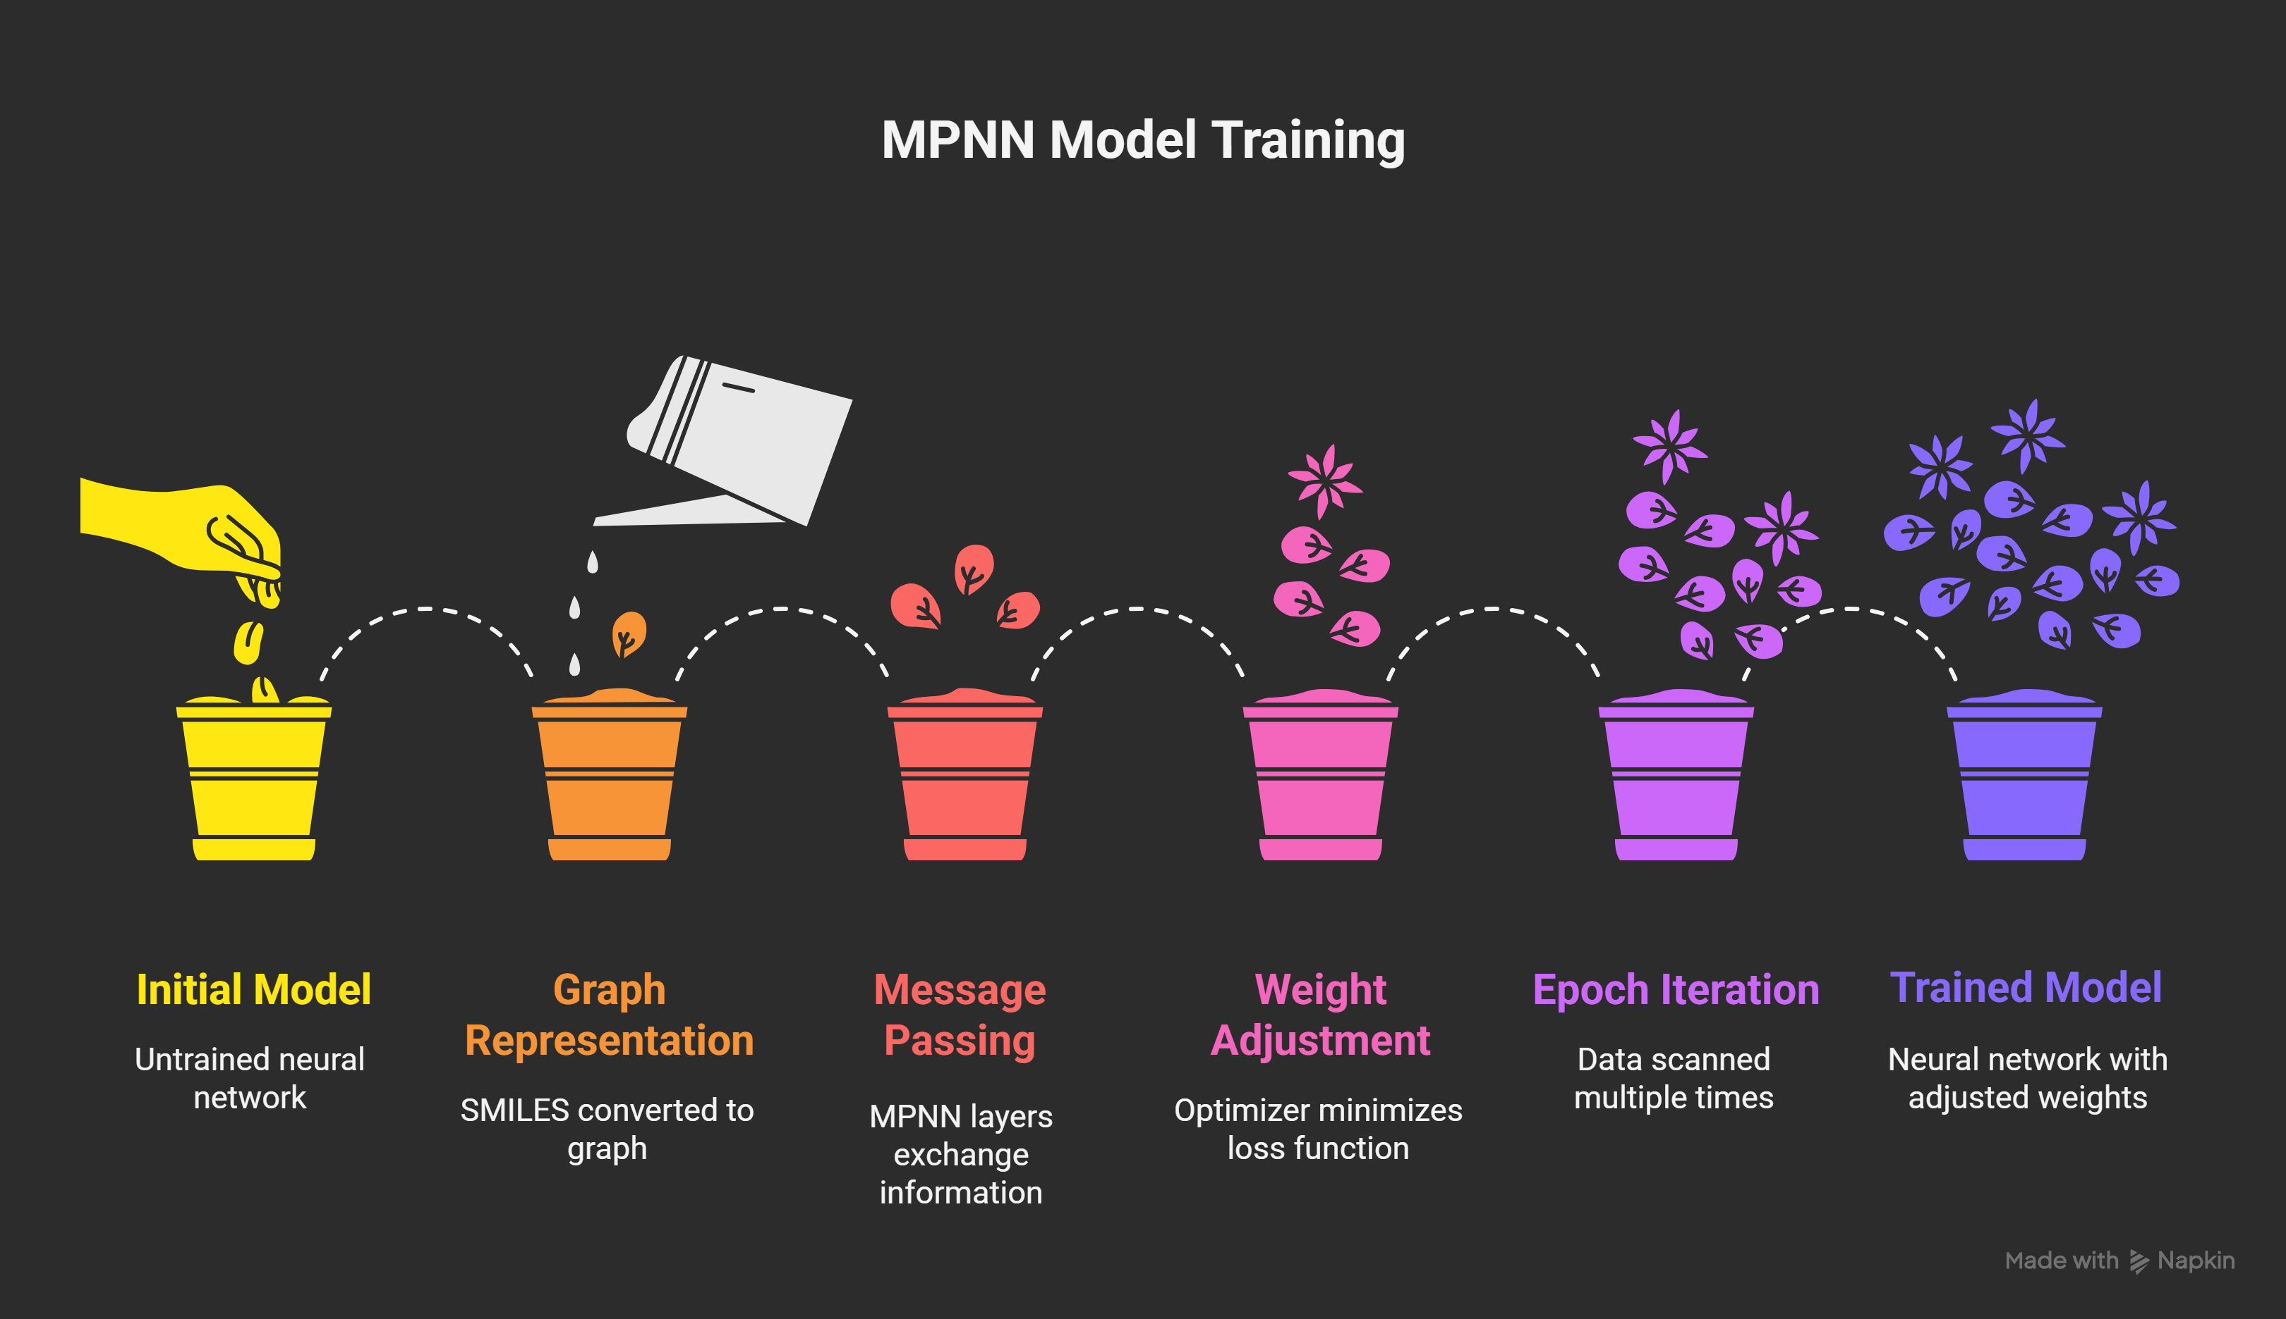

Slide 14
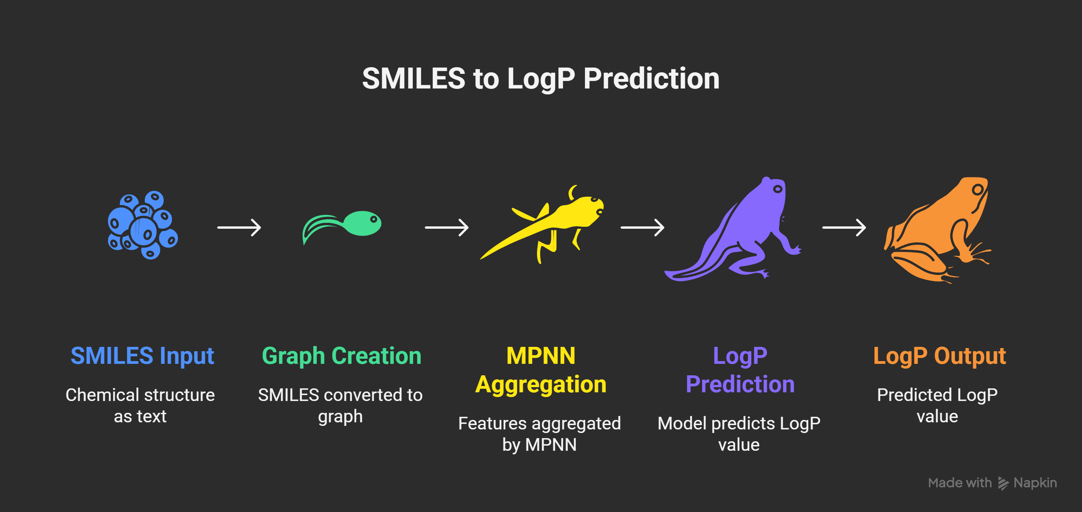

Slide 15
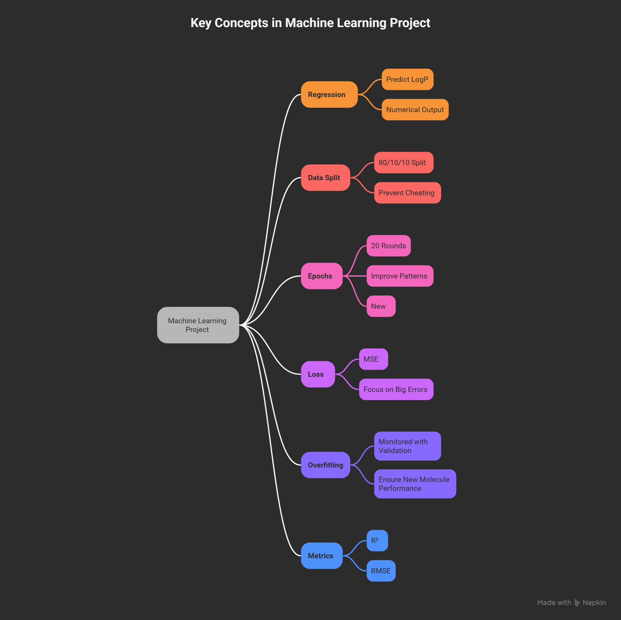

Slide 16
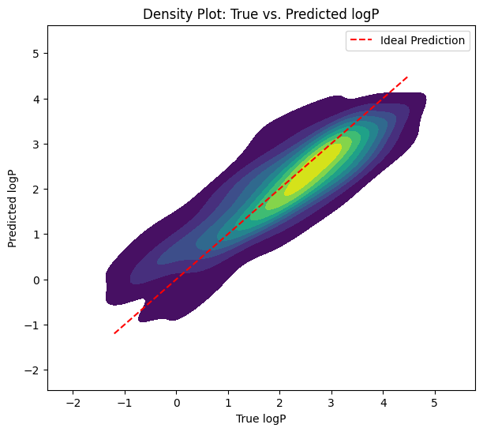
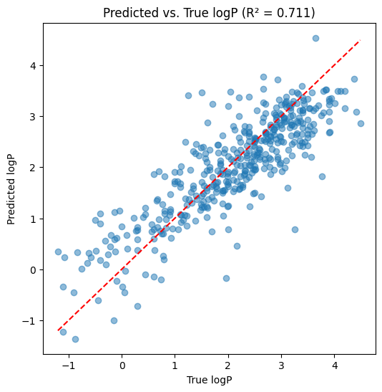

Slide 17
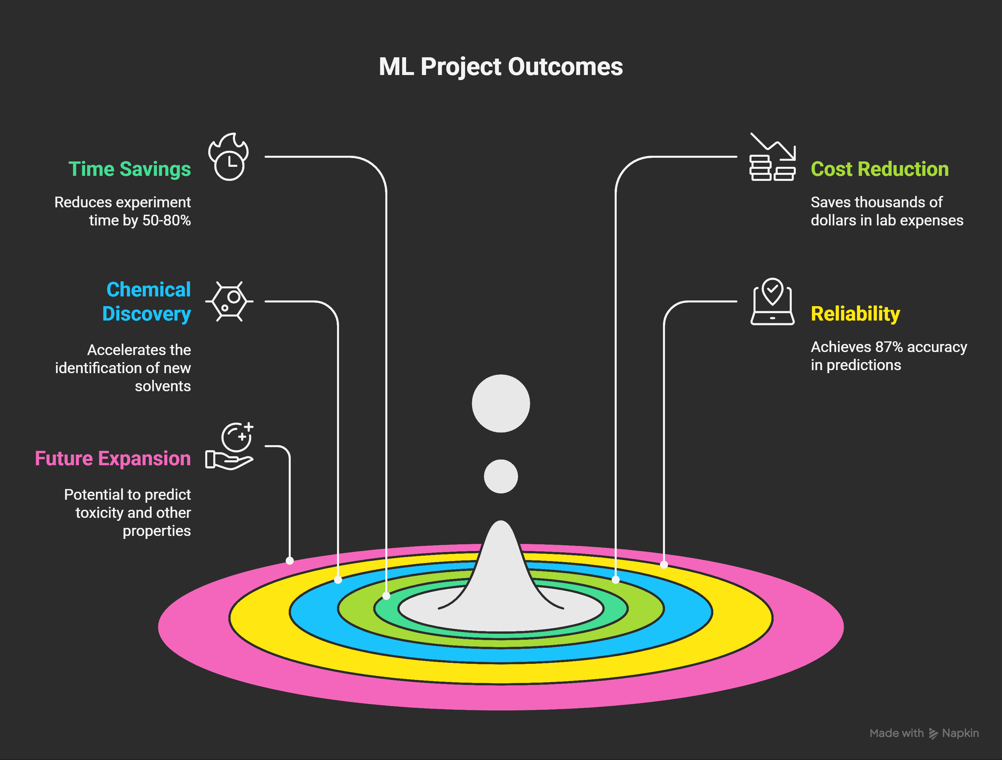

Slide 18
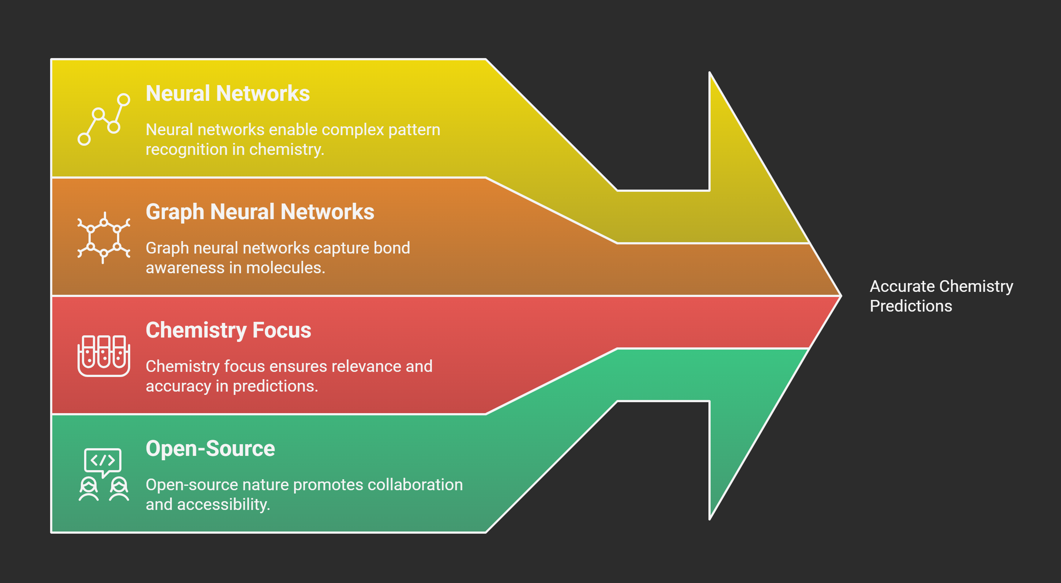

Slide 20
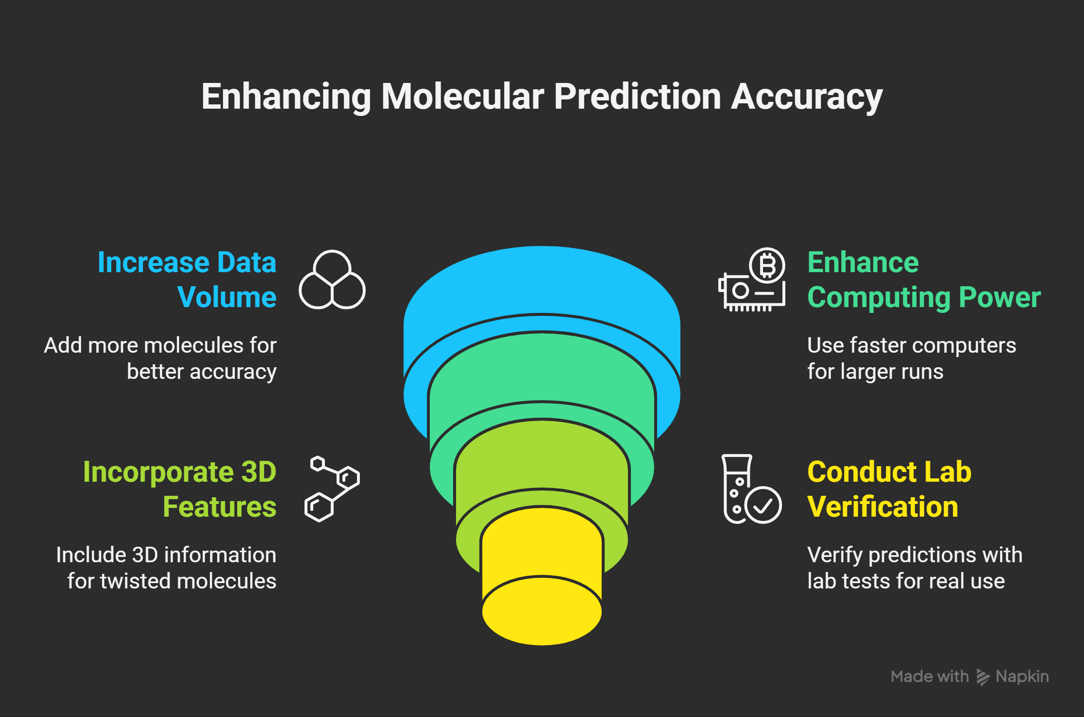

Slide 21
Key Citations:
Chemprop Documentation:
https://chemprop.readthedocs.io/en/latest/
Lipophilicity Dataset:
https://deepchemdata.s3-us-west-1.amazonaws.com/datasets/
Yang et al. (2019):
https://pubs.acs.org/doi/10.1021/acs.jcim.9b00237
MoleculeNet:
https://moleculenet.org/datasets

Slide 22
Thankyou👨‍🔬

